Slide 2
AI & Cybersecurity Training
The role of training and education
Stefano Prola
Assistant Director Safety & Flight Operations

Slide 3
Why matters
AI and cybersecurity closely related.
Challenges/opportunities for cybersecurity from AI: defense and offense.
Leverage AI benefits - mitigating cyber threat risks.
Notes:
- AI and cybersecurity are closely related, as both fields deal with data, algorithms, and complex problems.
- However, AI also poses new challenges and opportunities for cybersecurity, as it can be used for both defense and offense.
- Therefore, training for AI and cybersecurity is essential for organizations to leverage the benefits of AI while mitigating the risks.

Slide 4
Challenges
Data privacy
Ethical issues
Skill gap
Notes:
- Data privacy: AI requires large amounts of data to learn and improve its performance, but this data may contain sensitive or confidential information that needs to be protected. Techniques such as differential privacy and federated learning can be used to anonymize or encrypt data before sharing it with AI systems.
- Ethical issues: AI may have unintended or harmful consequences on human rights, values, or norms, such as bias, discrimination, or manipulation. Techniques such as explainable AI and ethical AI can be used to ensure transparency, accountability, and fairness in AI systems.
- Skills gap: AI requires specialized skills and knowledge to design, develop, and deploy effectively. However, there is a shortage of qualified professionals in both AI and cybersecurity fields. Techniques such as online courses, certifications, and mentoring can be used to train and upskill existing or new staff.

Slide 5
Training levels
Specialists
Front-line
All personnel
Notes:
Aviation needs to train personnel, in AI and Cybersecurity, at different levels.
Specialists to project cybersecurity protection and leverage the opportunities with AI for the organization.
Front-line employers who will manage and implement the tools.
All personnel to handle in their everyday job the cyber threat and the AI features.

Slide 6
Cyber internal training
IATA has initial and recurrent cyber training mandatory for all personnel.
Frequent fake phishing emails, to test the system, are sent.
Report phishing button on outlook ribbon.
Notes:
IATA has initial and recurrent cyber training mandatory for all personnel.
Frequent fake phishing emails, to test the system, are sent.
Report phishing button on outlook ribbon.

Slide 7
IATA Cyber/AI training
Aviation Cyber Security
Aviation Cyber Security Audit and Inspection
Aviation Cyber Security Management Diploma
Operational Cyber Security in Aviation
Evolving Digital Risks Information and Communications Age
Notes:
Aviation Cyber Security (classroom) (LIVE virtual classroom)
This course will help your organization determine where to start in what can seem like a never-ending effort to protect your information and systems.
Aviation Cyber Security Audit and Inspection (classroom) (LIVE virtual classroom)
Industry-wide skills on audit requirements to carry out quality control of both airline and other aviation-related cyber security policies and processes.
Aviation Cyber Security Management Diploma
Gain complete and updated knowledge on the current cyber security issues and best practices with this Diploma, that has a unique focus on aviation.
Operational Cyber Security in Aviation (LIVE virtual classroom)
Providing you with more in-depth skills to evaluate and mitigate the risk of a cyber-attack, protect your critical systems, information, assets and data in aviation.

Slide 8
AI approach Education!
Guidance on the use of Next Generation Technologies (NGT).
Use only authorized NGT.
Notes:
Principles for the ethical and responsible use of Next Generation Technologies (NGT).

Slide 9
Conclusion
Organizations should invest in training for AI and cybersecurity to gain a competitive edge and ensure digital resilience.

Slide 10
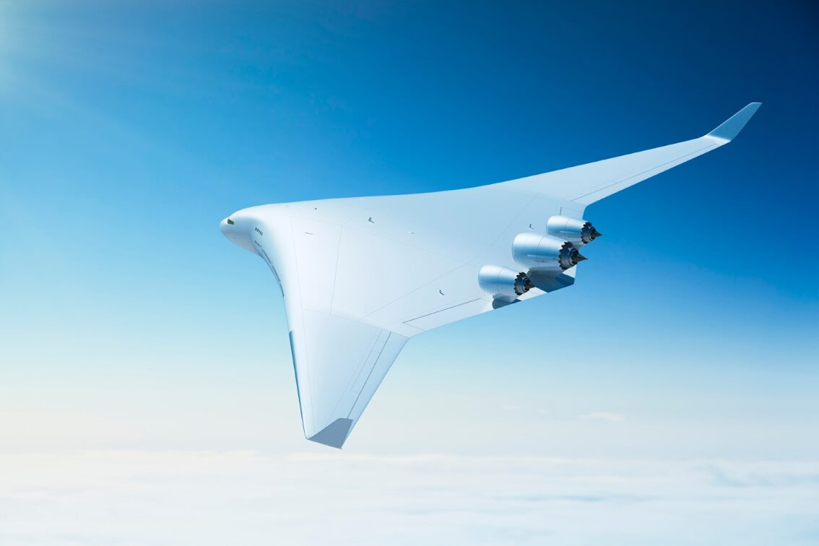
Thank you
prolas@iata.org

